Slide 1
ACCY577 Machine Learning for Accounting
Module 8: Introduction to Time Series Data
Linden Lu

Slide 2
Lesson 1: Working with Times and Dates
Date Time Related Modules
time
datetime
time
date
datetime
timezone
timedelta

Slide 3
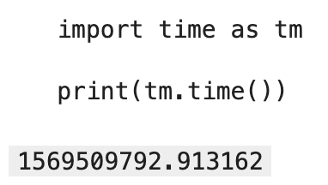
time
Epoch: 1/1/1970(UTC)
timestamp

Slide 4
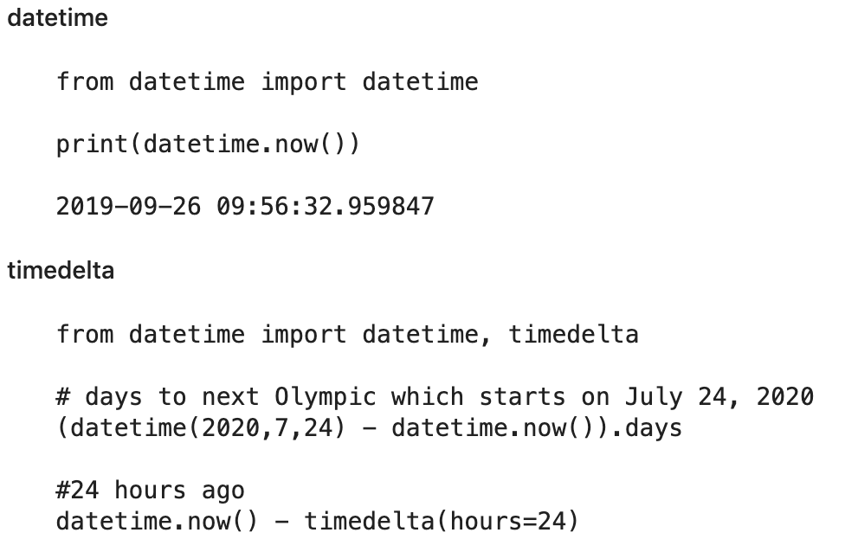
datetime

Slide 5
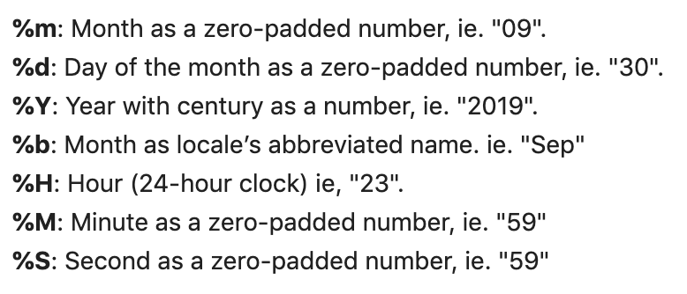
Datetime Format

Slide 6
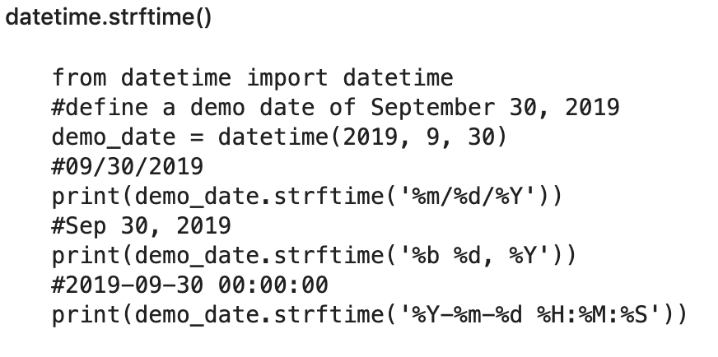
Datetime to String

Slide 7
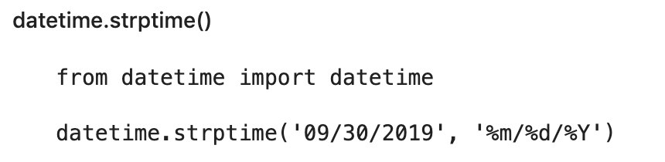
String to Datetime

Slide 8

DataFrame datetime Manipulation

Slide 9
Lesson 2: Analyzing Time Series Data
Time Series Data
A series of data points indexed in time order.
Normally with equal intervals between indexes.
Examples
Daily Dow Jones Index Close
Hourly Weather Data

Slide 10
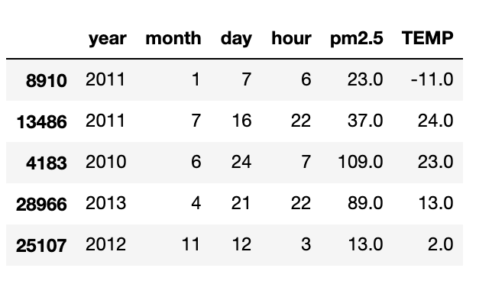
Data - Beijing Environment

Slide 11
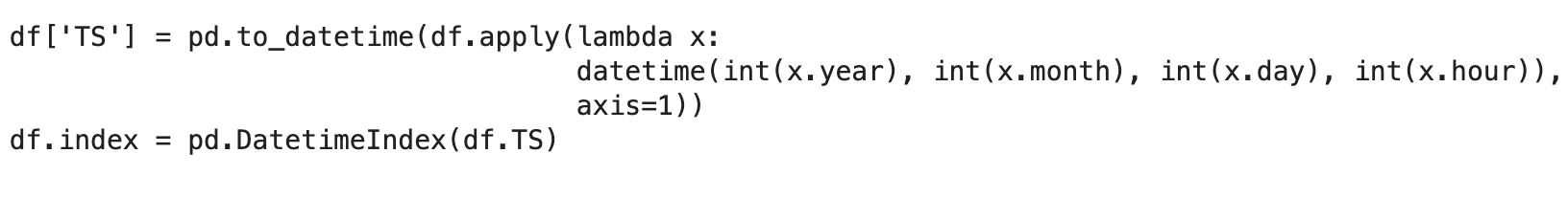
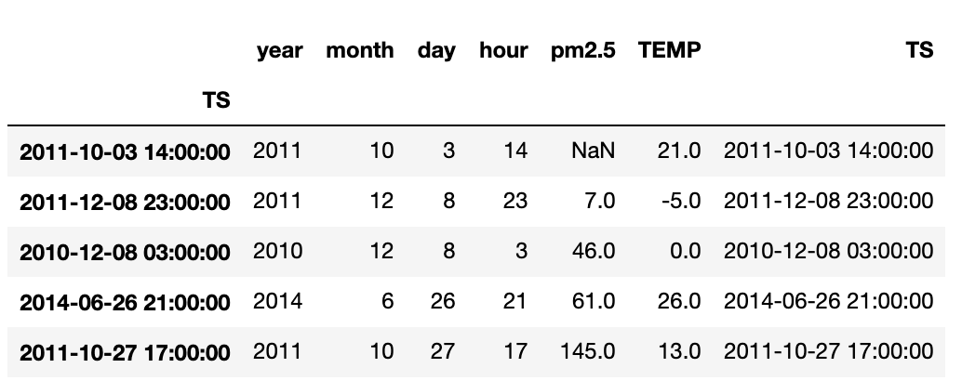
Create Time Index

Slide 12
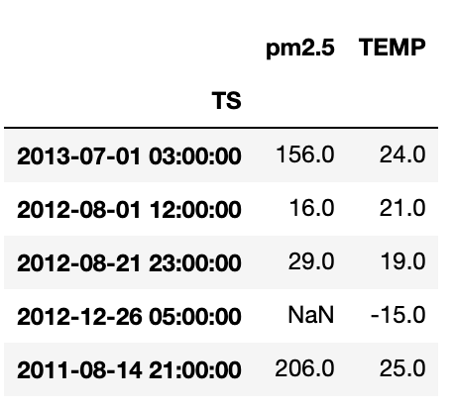
Create Time Index

Slide 13

Handling Missing Values

Slide 14
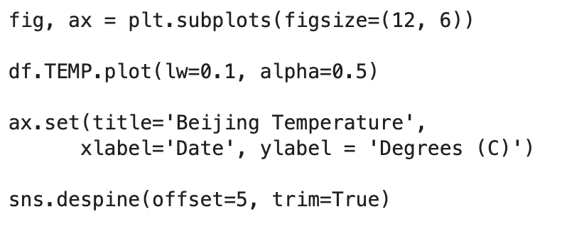
Plot Time Series Data

Slide 15
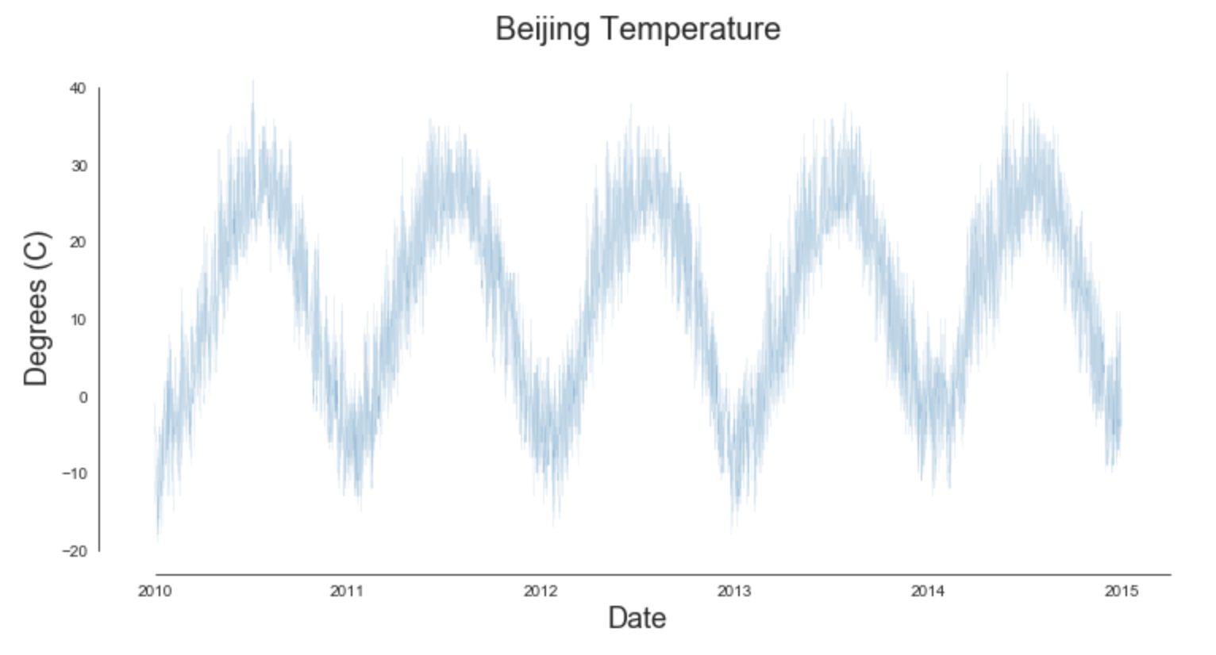
Plot Time Series Data

Slide 16
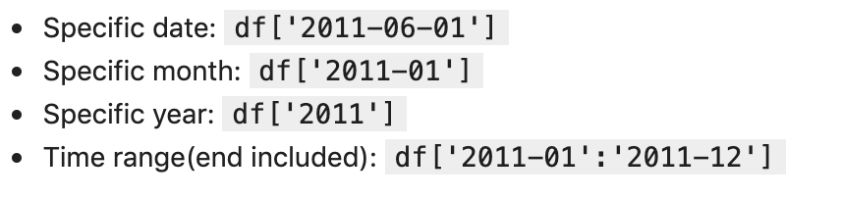
Time Series Data Slicing

Slide 17
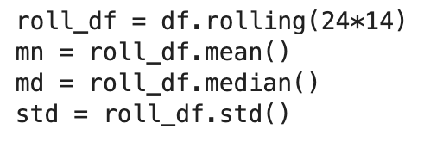
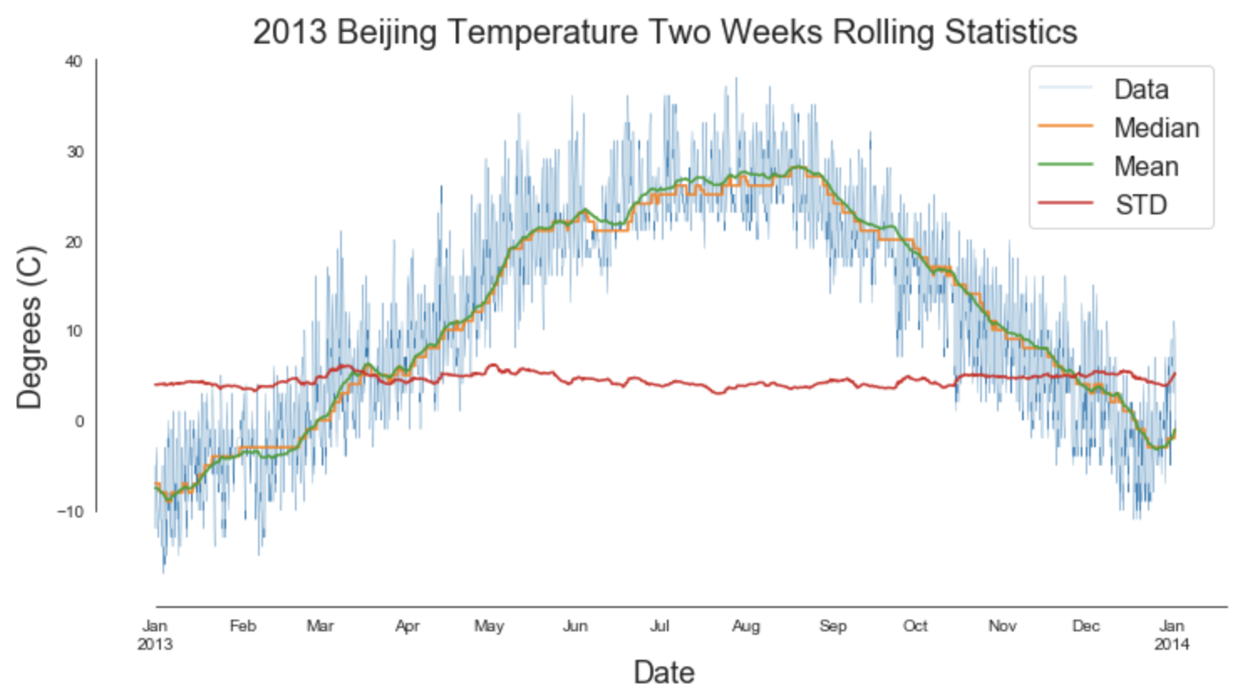
Rolling Statistics

Slide 18
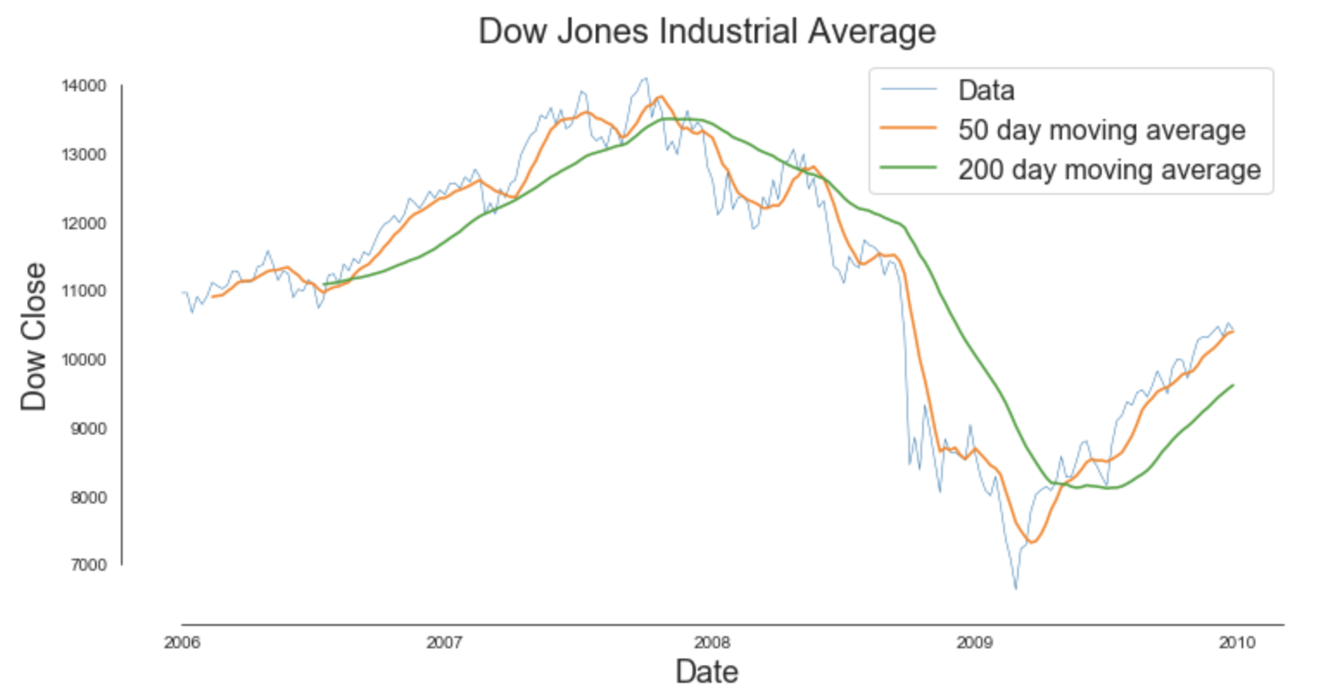
Death Cross

Slide 19
Resampling
B: business day frequency
D: calendar day frequency
W: weekly frequency
M: month end frequency
BM: business month end frequency
MS: month start frequency
BMS: business month start frequency

Slide 20
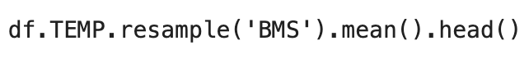
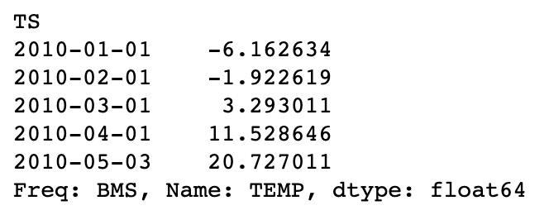
Resampling

Slide 21
Seasonal Decomposition
Level: The average value in the series.
Trend: The underlying trend in the series.
Seasonality: The repeating short-term cycle in the series.
Noise: The random variation in the series, aka residual.

Slide 22
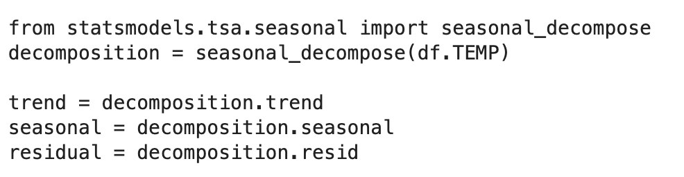
Seasonal Decomposition

Slide 23
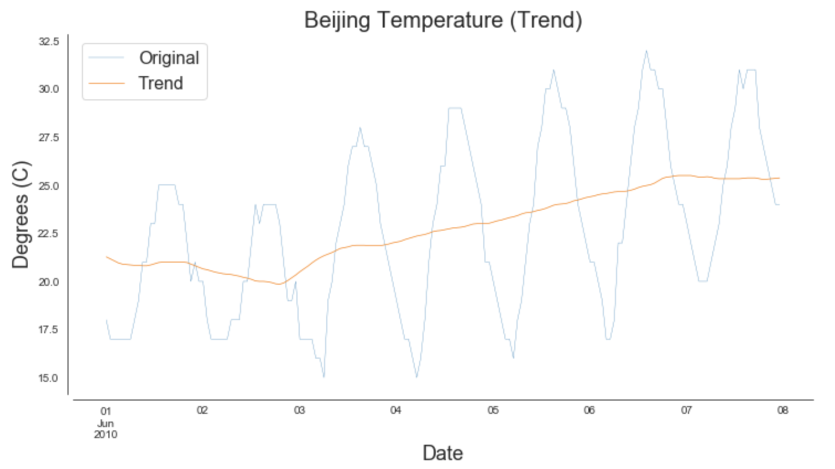
Seasonal Decomposition
Trend

Slide 24
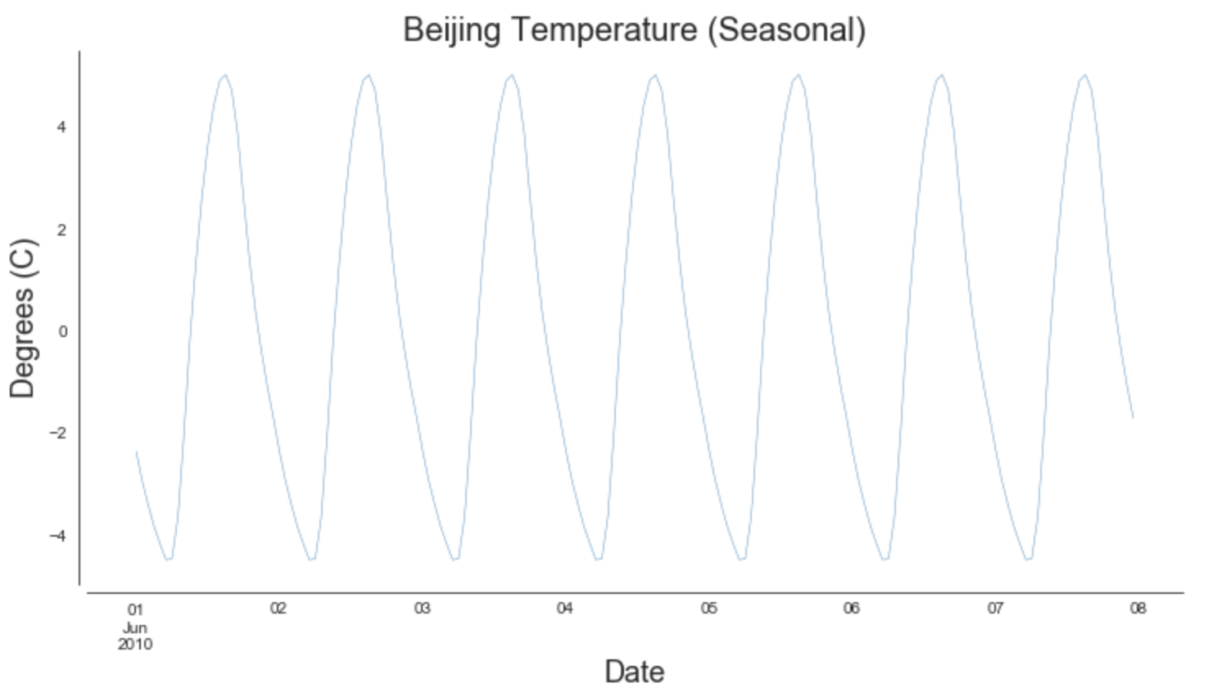
Seasonal Decomposition
Seasonality

Slide 25
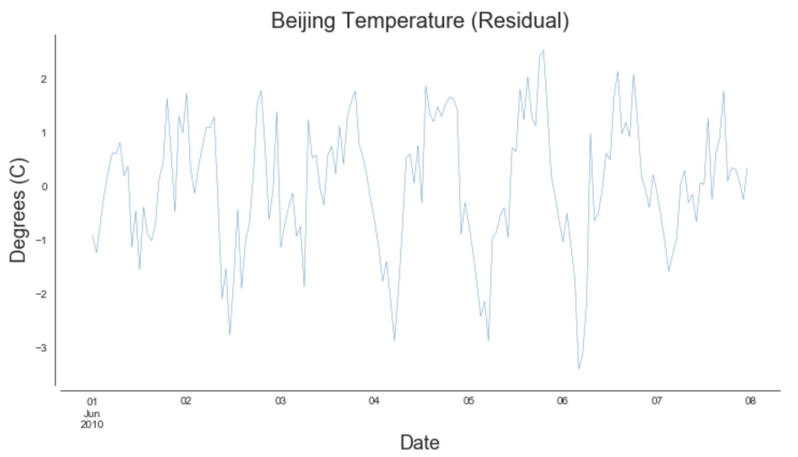
Seasonal Decomposition
Residual

